Slide 1
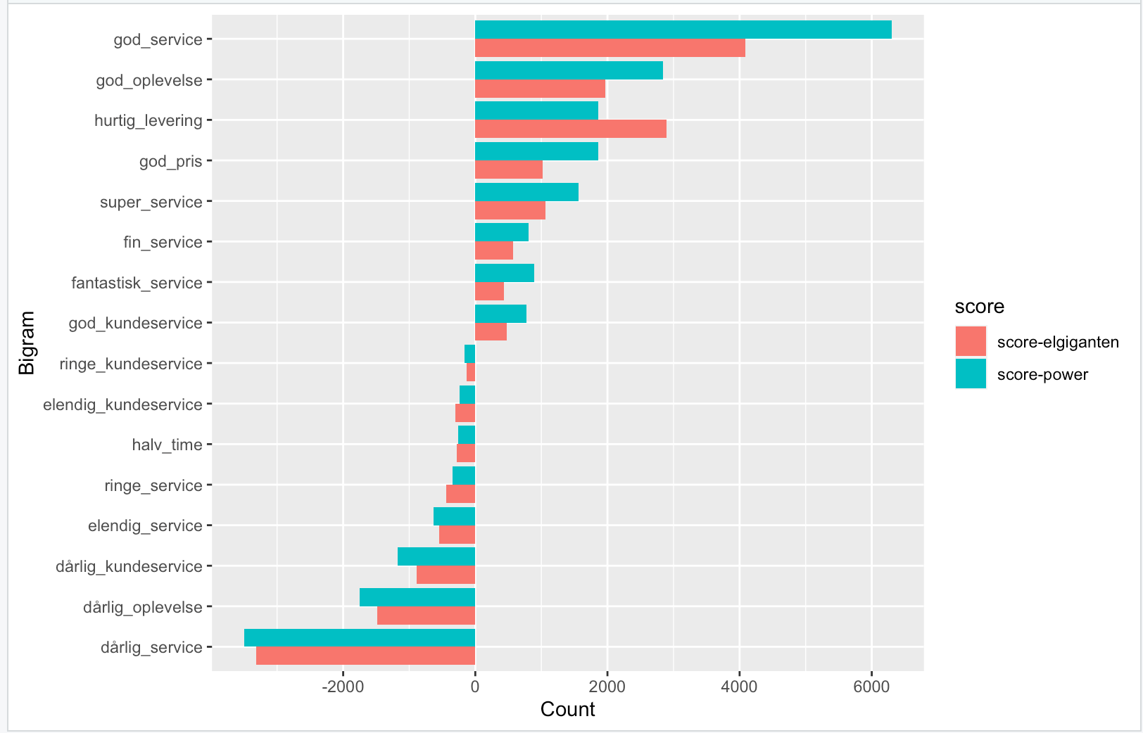
Som
leder af Elgigantens serviceafd
vil jeg
gerne kunne se hvordan vi performer på vores KPI’er sammenlignet med konkurrenterne
så jeg
ved hvor der skal forbedres.

Slide 2
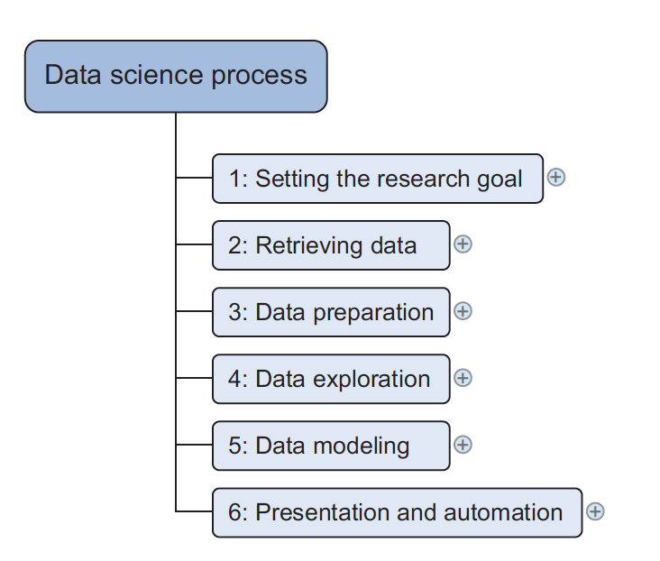
Processen

Slide 3
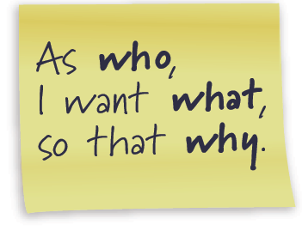
Research Goal - User Story
As a <role> I can <activity> so that <business value>
… is short, simple description of a feature told from the perspective of the person who desires the new capability (typically user or customer)
formal template
As a registered user,
I want to reset my password,
so that I can get back into the site if I forget my password

Slide 4
Research Goal - Writing good User Stories
I
N
V
E
S
T
ndependent
egotiable
aluable
stimable
mall / appropriately sized
estable

Slide 5
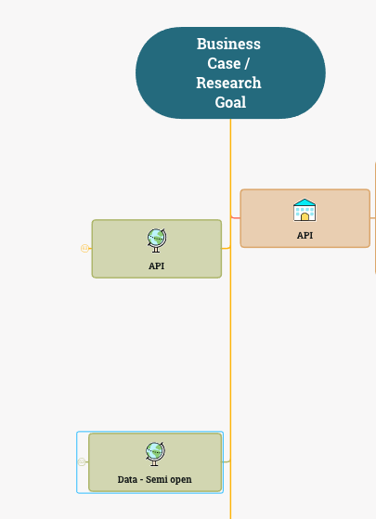
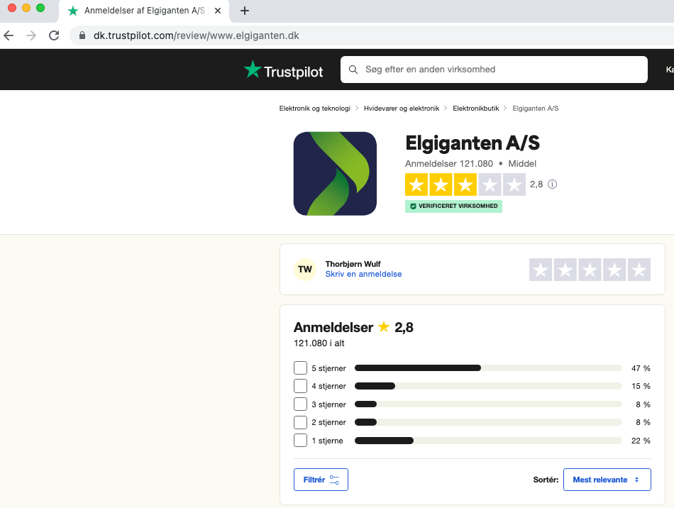
Data retrieval - I

Slide 6
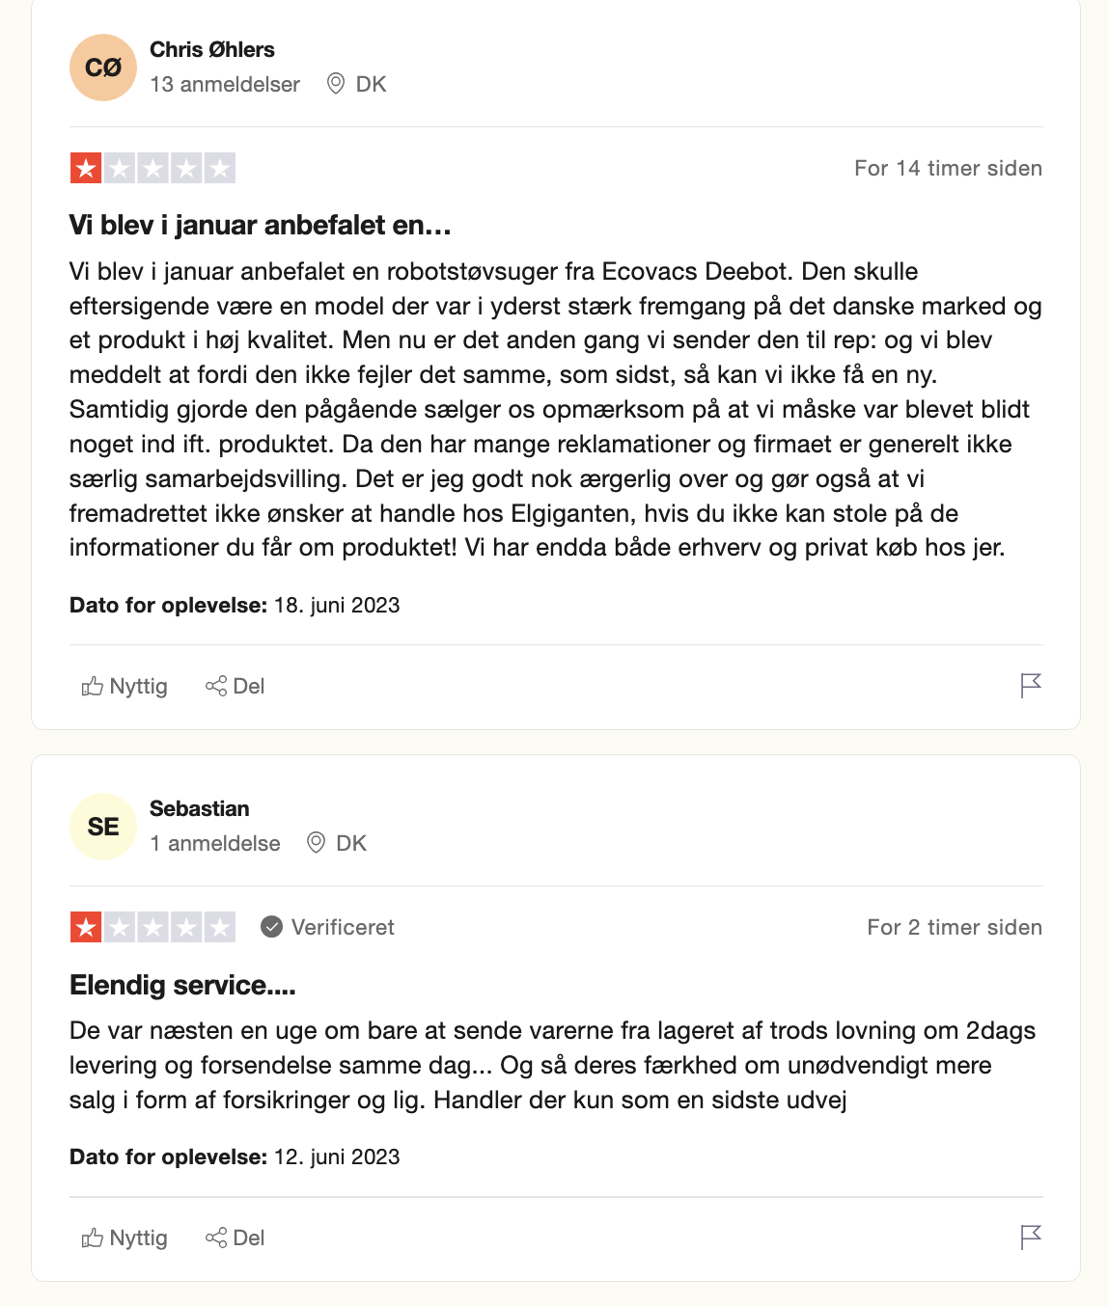
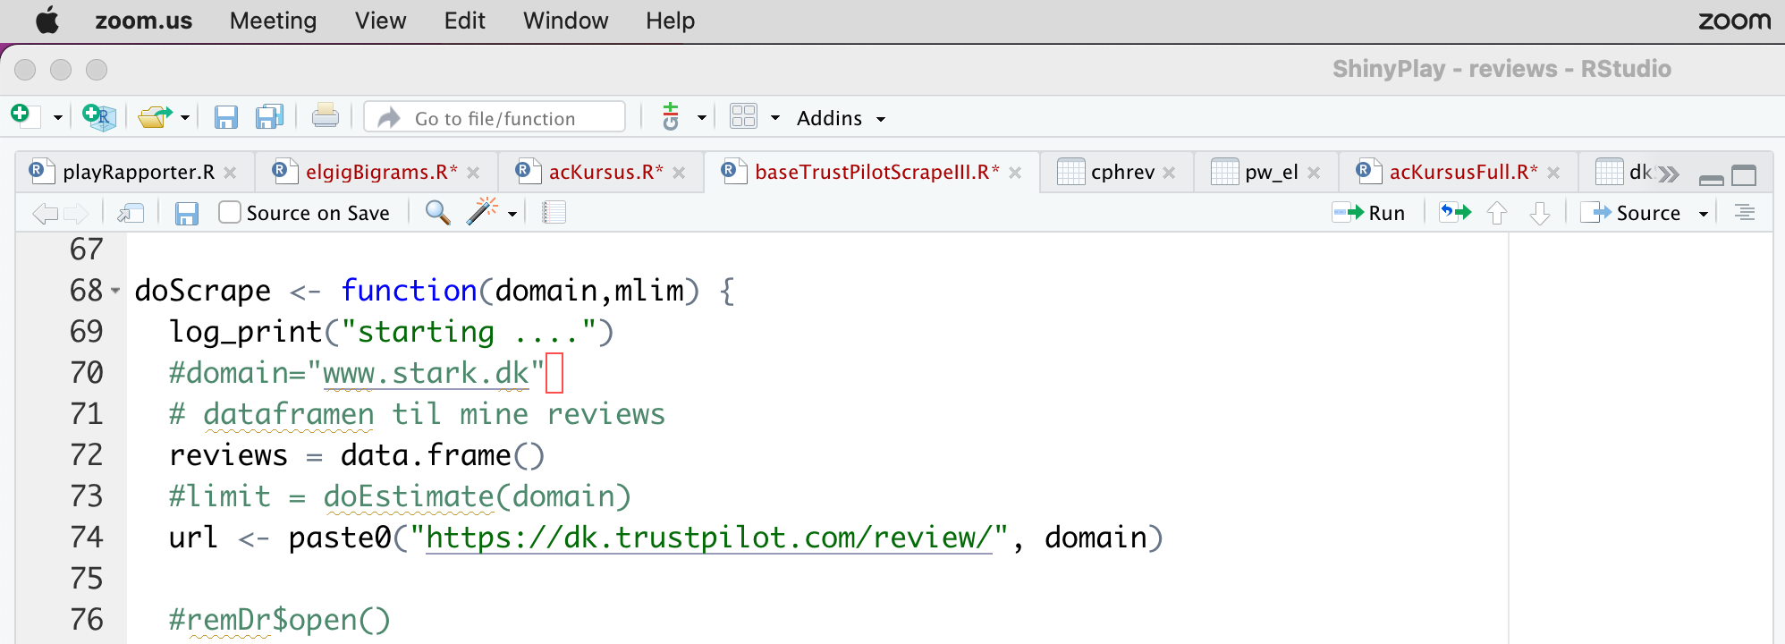
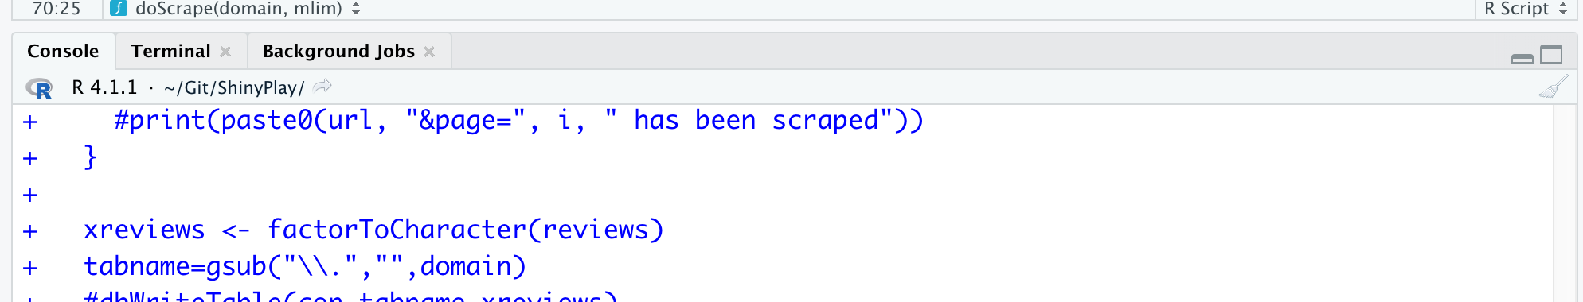
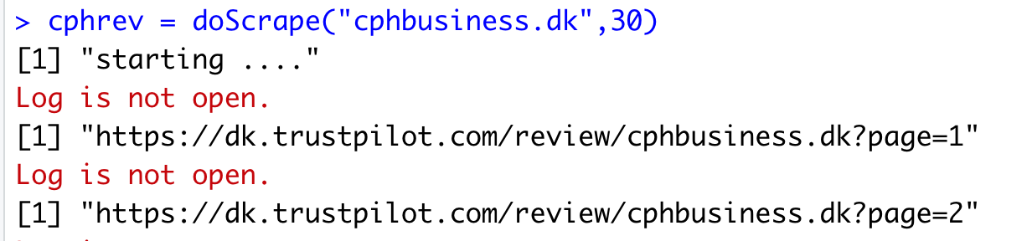

Data retrieval - II

Slide 7
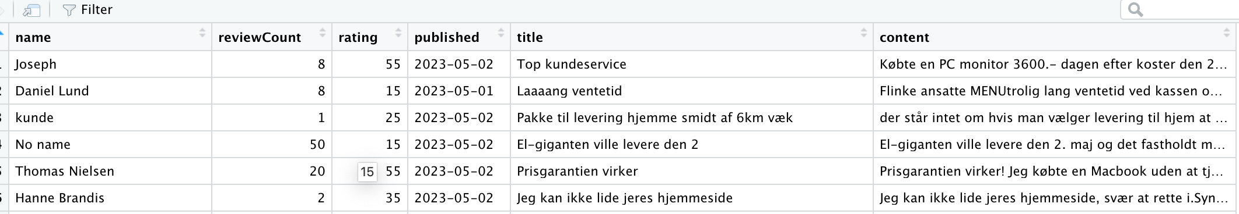
Data cleaning

Slide 8
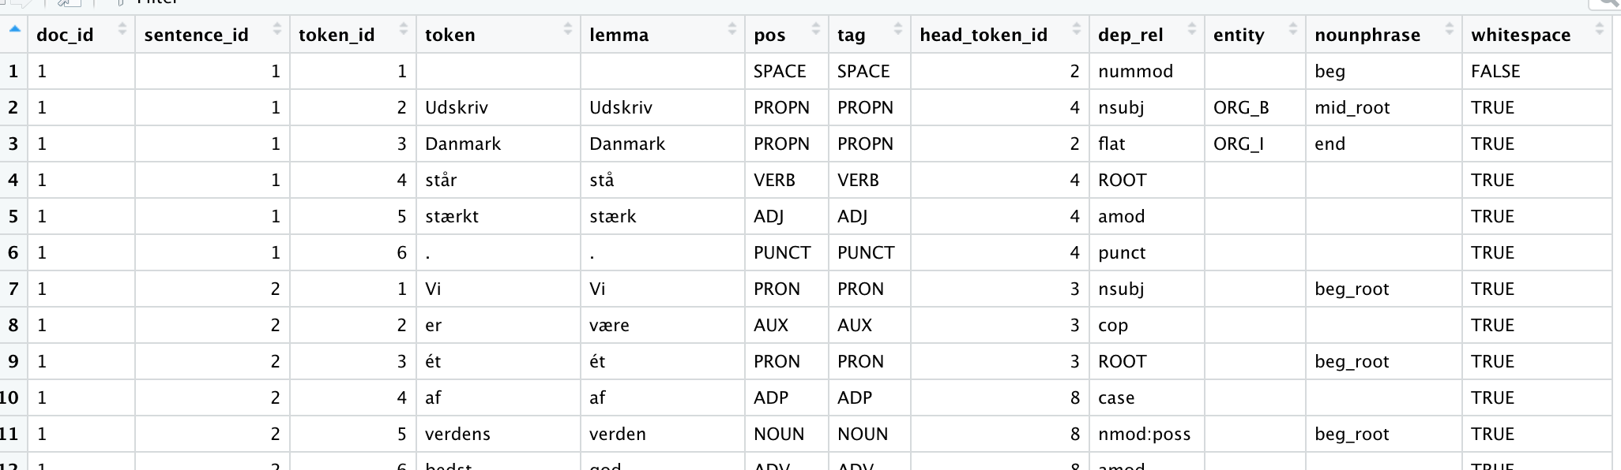
Data transformation

Slide 9
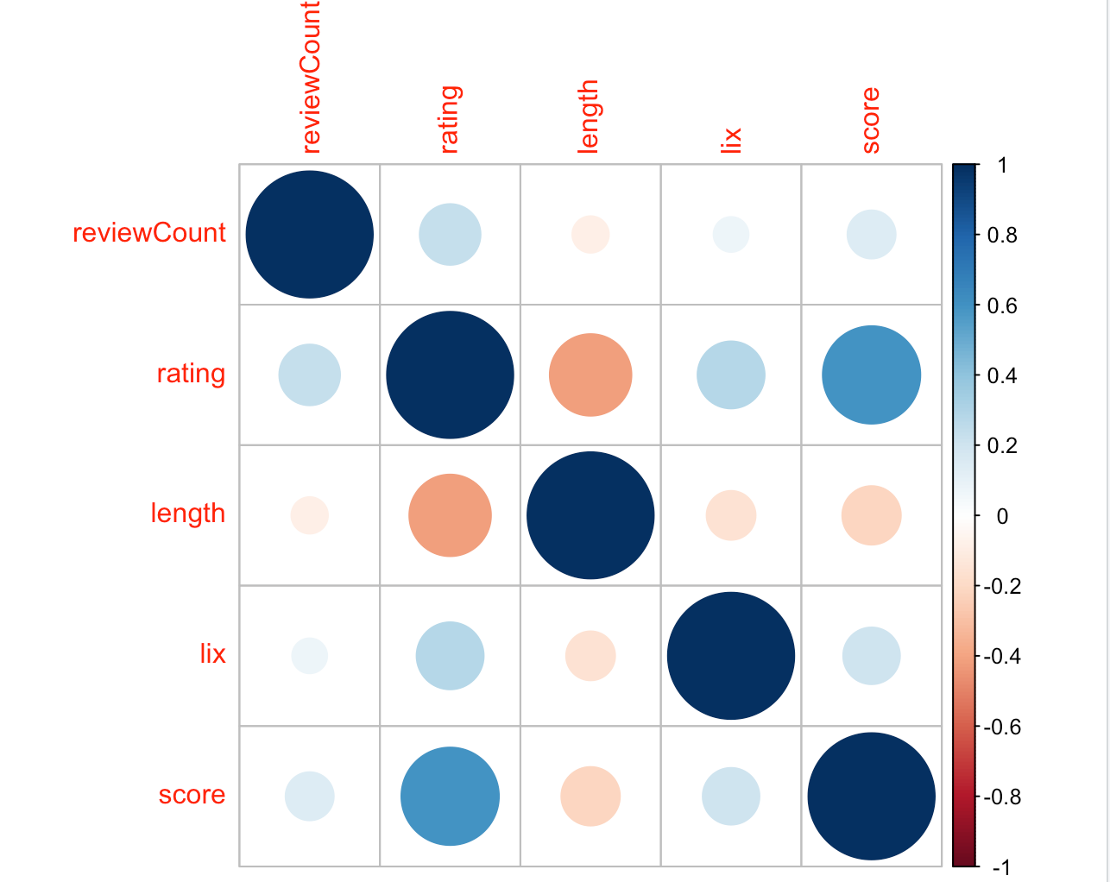
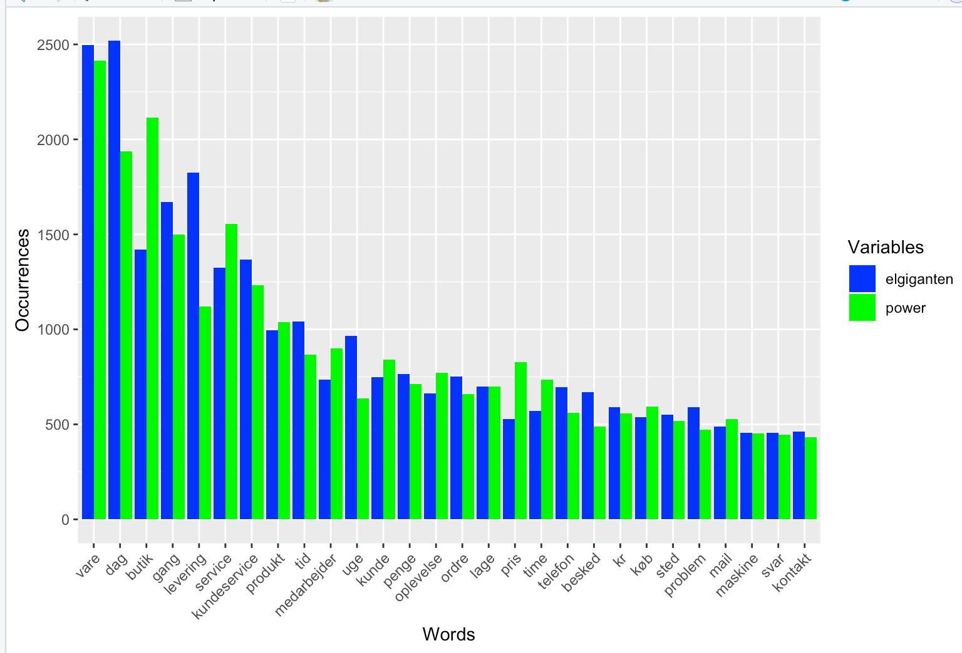
Data exploration

Slide 10

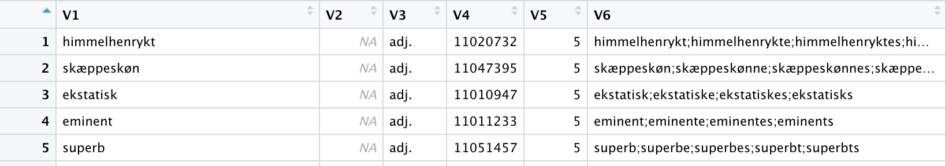
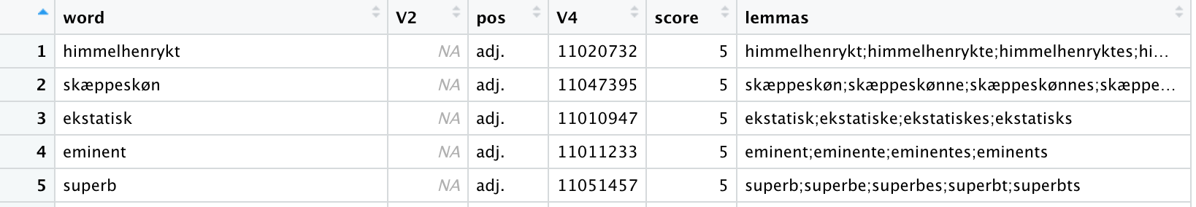
Data preparation II – Merging dataset

Slide 11
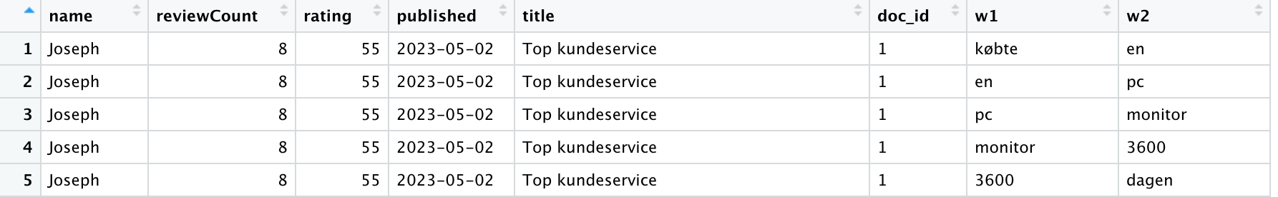
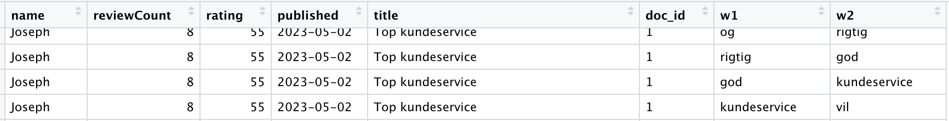
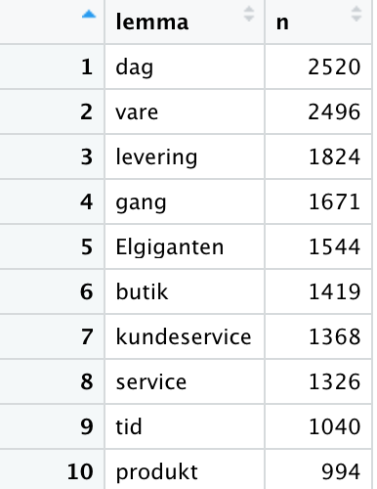
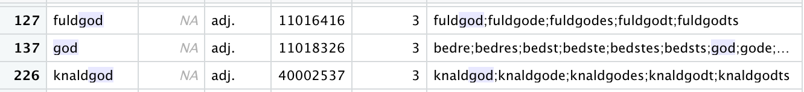
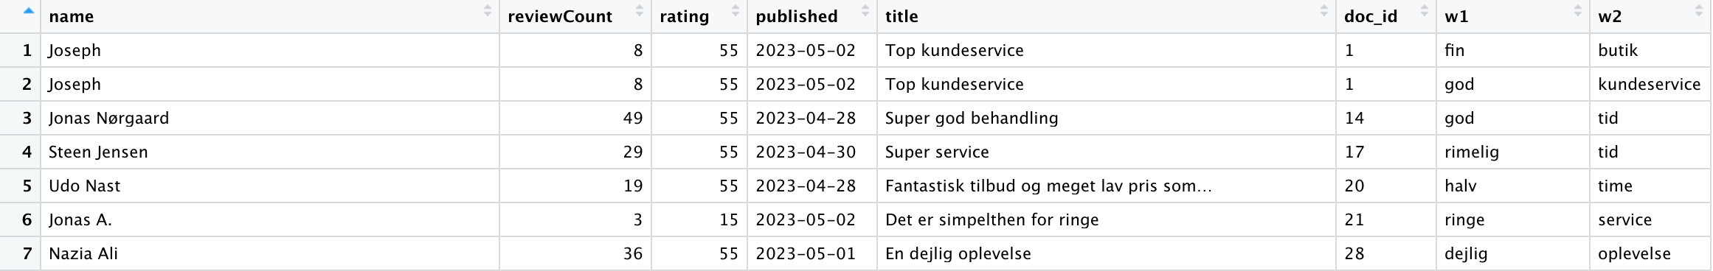
Data transformation
elgrams_sep
elNounsC
dkSenti_adj
el_bigrams_filtered

Slide 12
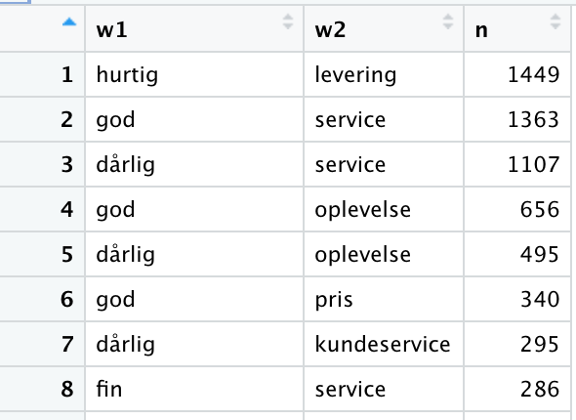
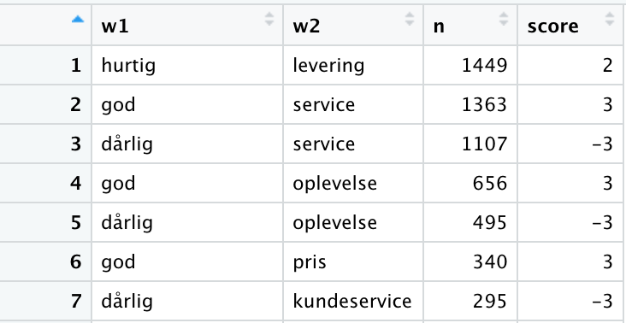
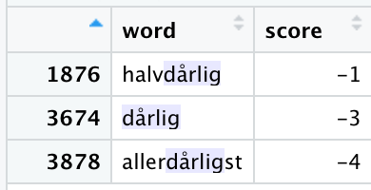
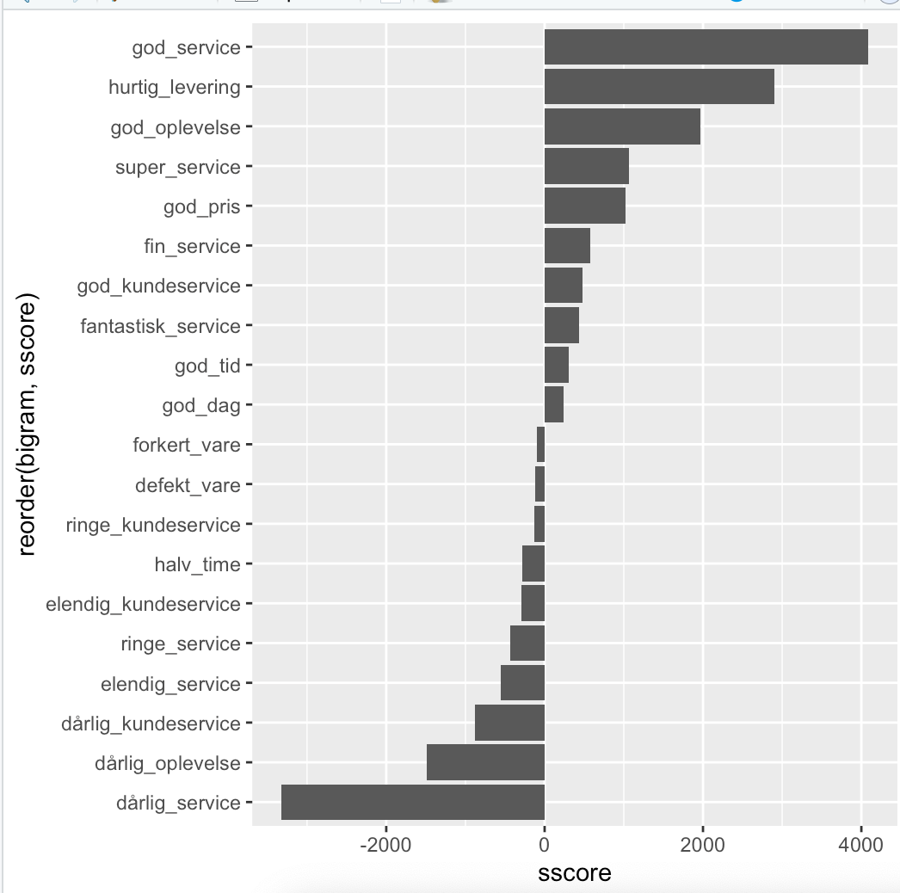
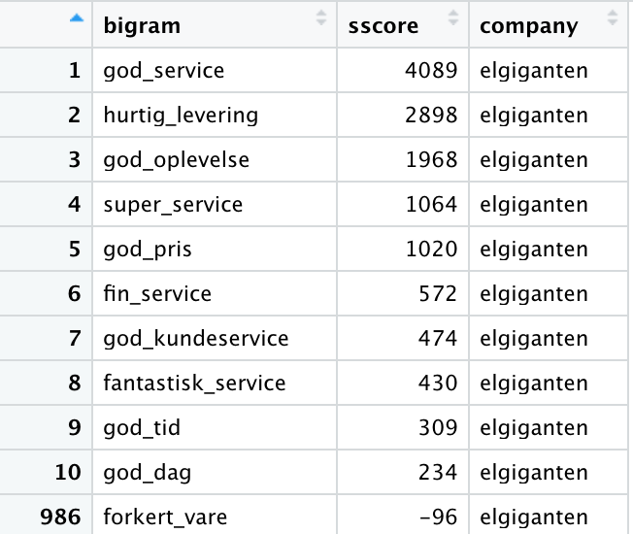
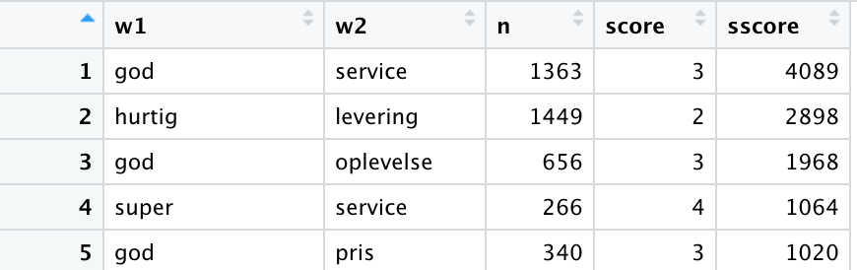
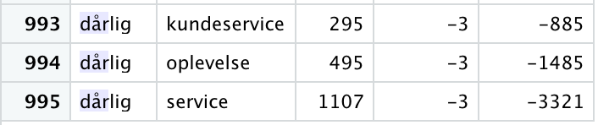
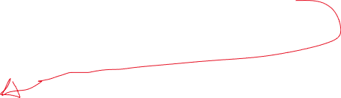
Data transformation
el_bigram_counts
dkSenti_adj_sm
el_bigram_counts_sent
el_tot_plot
el_bigram_counts_sent_scored

Slide 13
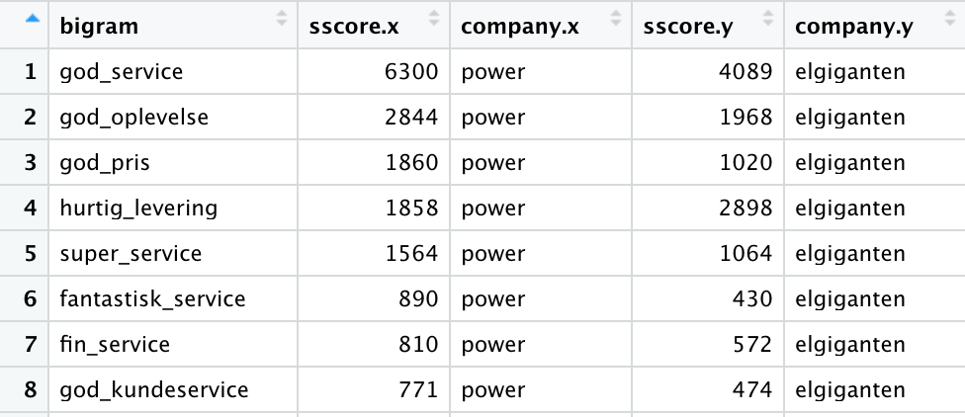
Data transformation

Slide 14
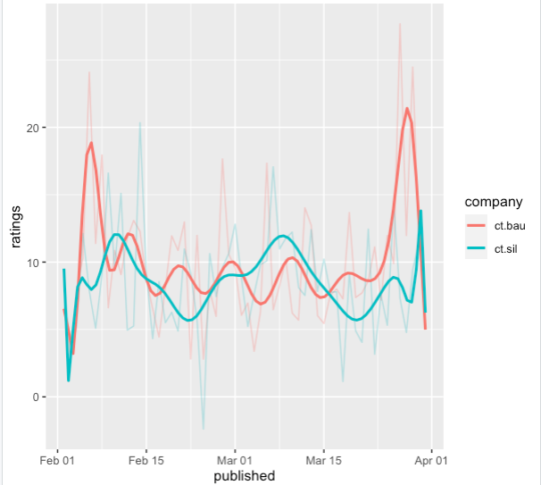
Data exploration – Bauhaus vs Silvan

